Slide 1
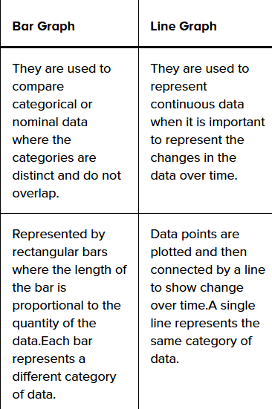
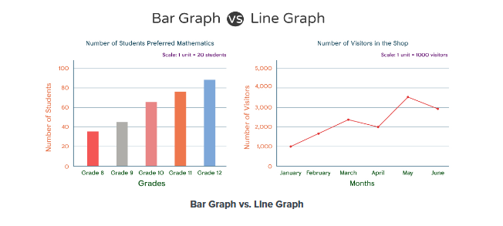

Slide 2
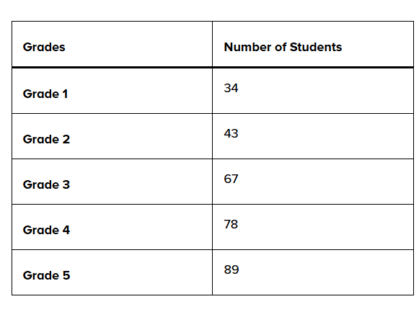
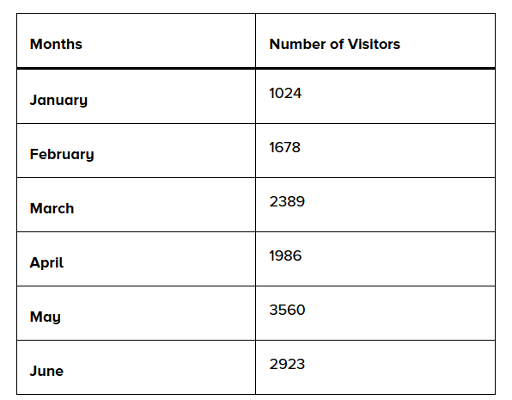
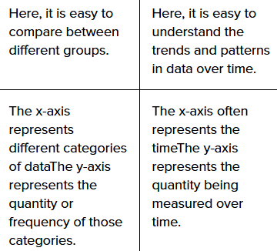

Slide 3
Dual-axis charts
A dual-axis chart is a type of data visualization that displays two sets of data on the same chart but uses two different y-axes for each dataset. This is particularly useful when comparing two data series with different units or scales.
Dual-axis charts are popular because they offer a way to compare two different sets of data that may have different units or scales on the same chart, making it easier to observe relationships, patterns, or correlations
Applications
Finance: Visualizing stock price against trading volume to show the relationship between price movements and market activity.
Marketing: Comparing website traffic against conversion rates to see if traffic changes correlate with user engagement or sales.
Operations: Monitoring production output against labor hours to assess productivity.

Slide 4
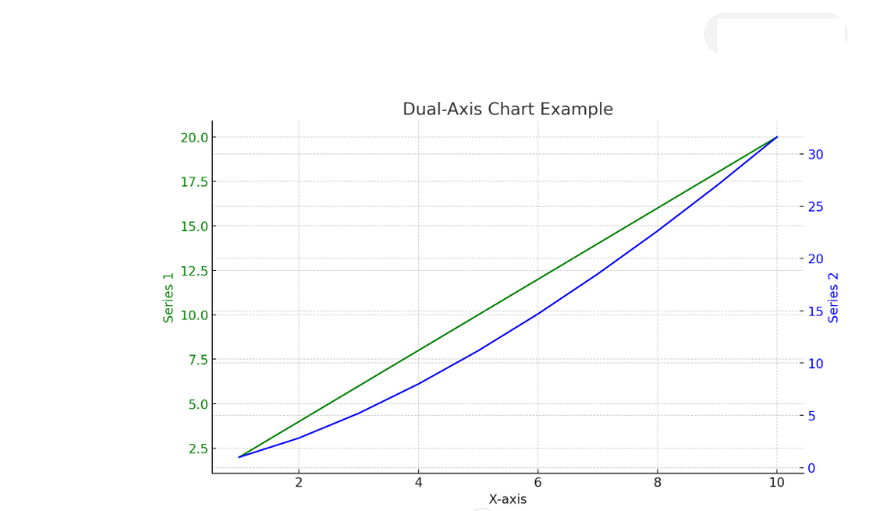

Slide 5
A retail company wants to evaluate how its marketing expenditures influence product sales over a one-year period. The company has monthly data on total sales revenue and marketing spend. The challenge is that these two metrics have different units (dollars for sales and dollars for marketing).
Objective: Determine if there is a correlation between marketing spending and sales revenue and understand how changes in marketing budget affect sales.

Slide 6
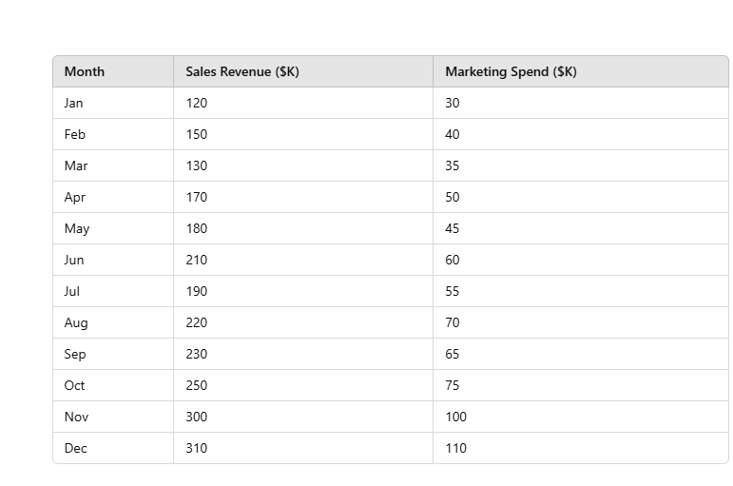

Slide 7
Approach:
Dual-Axis Chart: Plot the sales revenue on the left y-axis and the marketing spend on the right y-axis, with both datasets sharing the same x-axis representing the months.
Visualization Details:
Primary Y-axis (left): Total sales revenue.
Secondary Y-axis (right): Marketing spend.
X-axis: Months of the year.
Series Representation: Sales revenue can be shown as a line chart (e.g., green line), and marketing spend as another line or bar chart (e.g., blue line).

Slide 8
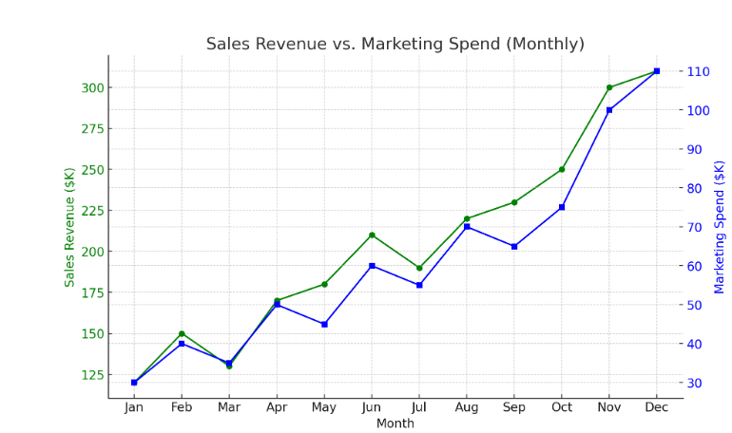

Slide 9
The dual-axis chart shows a positive relationship between marketing spend and sales revenue, with both peaking in November and December. This suggests that increased marketing investments are correlated with higher sales, especially during the holiday season. This insight can guide better budget planning and targeted marketing strategies for maximizing revenue.

Slide 10
Pie charts are used in data science to visually represent the proportion of different categories within a dataset. While they are popular for showing simple composition, modern data science practices often use them selectively due to their limitations.

Slide 11
Pie charts are used to represent the proportional data or relative data in a single chart. The concept of pie slices is used to show the percentage of a particular data from the whole pie.
Measure the angle of each slice of the pie chart and divide by 360 degrees.
(Given Data/Total value of Data) × 360°
Now multiply the value by 100. The percentage of particular data will be calculated.

Slide 12
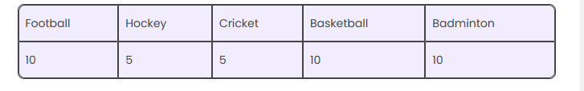
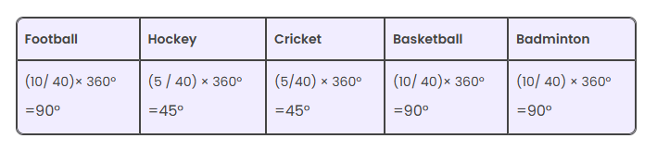
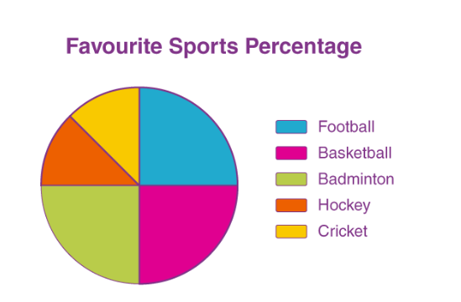

Slide 13
histogram is used to visualize the distribution of a dataset
Identifying Skewness: Histograms can reveal whether data is skewed to the left or right, indicating if most of the data points are concentrated on one side of the distribution.

Slide 14
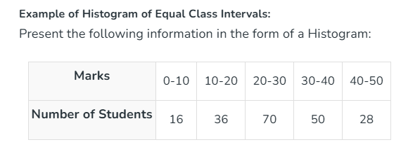
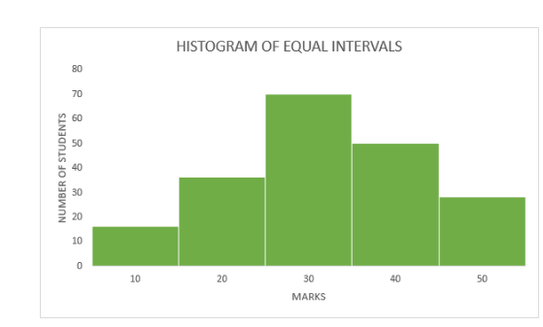

Slide 15

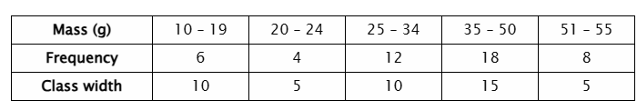
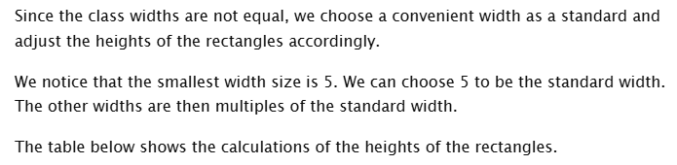

Slide 16
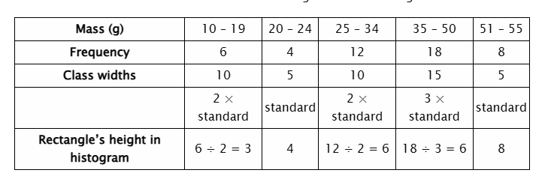
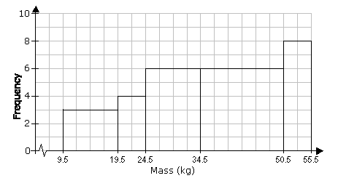

Slide 17
Doughnut charts are used for visualizing data that represents parts of a whole
Clear Representation of Proportions: Doughnut charts help show the proportion of categories in a dataset relative to the total. This is useful for quickly understanding the contribution of each category to the whole
Data Comparison: When comparing different segments of categorical data, a doughnut chart makes it easy to visualize which segments are larger or smaller and by how much.

Slide 18
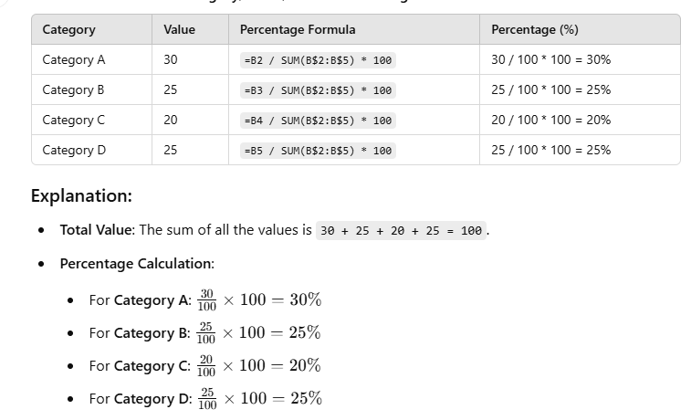
to calculate the percentage or proportion each segment contributes to the whole

Slide 19
